Slide 1

IIS (Deemed to be University), Jaipur
Multi-Agent AI Assessment System
B.Sc.(H) in Data Analytics and Artificial Intelligence
Submitted to: Dr. Ruchi Nanda Assistant Professor (SG) Department of CS&IT | Submitted by: Ms. Teena Sharma Enroll no.: IISU/2023/ADM/35803 Roll no.232025

Slide 2
PROBLEM STATEMENT
Manual evaluation of exam papers is time-consuming and inconsistent. Teachers spend a large amount of time checking whether questions match the syllabus, identifying their cognitive level, and grading student answers one by one. Different teachers may grade the same answer differently, leading to unfair results. There is no automated system at IIS University that can analyze question papers, detect Bloom's Taxonomy levels, evaluate student answers intelligently, and provide transparent and explainable feedback to both teachers and students.

Slide 3
Objective
To build a web-based system that automatically extracts and analyses CA question papers using Vision AI and detects Bloom's Taxonomy levels (L1–L6).
To evaluate student answers using a four-agent AI pipeline combining keyword scoring and semantic understanding, generating final marks out of 15.
To measure Course Outcome (CO) attainment on a 0–5 scale aligned with NBA accreditation standards.
To provide role-based access for teachers and students, where students can independently view their personalized AI feedback.

Slide 4





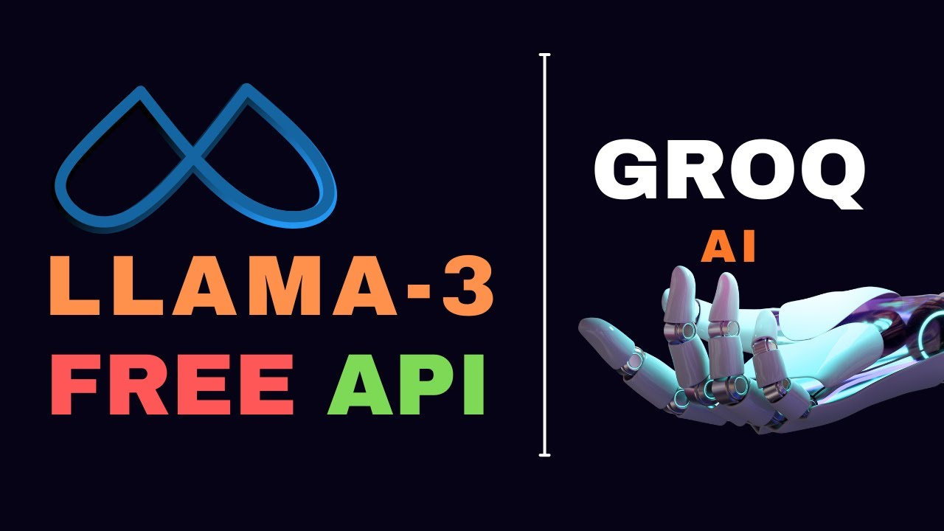


TOOLS AND TECHNOLOGIES
1. Python 3.11
Python was the main programming language used for the entire backend. It handled all routing, database operations, AI API calls, file processing, and Excel generation.
2. Flask
Flask was used as the web framework to build the backend server. It managed all routes such as /login, /register, /assess, and /answer-evaluator, handled sessions for user authentication, and connected the frontend with the AI logic.
3. Groq LLM API (Llama 3.3) API
Groq LLM API was used as the core AI engine for all four agents. It processed question paper images using Vision AI, detected Bloom's Taxonomy levels, extracted keywords, and evaluated student answers semantically.

Slide 5
4. HTML5, CSS3 and JavaScript
The complete frontend was built using plain HTML, CSS, and JavaScript without any heavy framework. All pages follow IIS University's official maroon and gold color theme.
5. SQLite
SQLite was used as the database. It auto-creates on first run and stores user accounts, question analysis results, teacher feedback, and student evaluation records.
6. OpenPyXL
OpenPyXL was used to generate downloadable Excel reports containing question analysis data and student evaluation results with all scores, grades, and feedback.
7. Chart.js
Chart.js was used to display a visual bar chart showing concept coverage in the answer evaluator — which concepts were covered and which were missing in the student's answer.
8. Pillow
Pillow was used for image processing when question papers were uploaded as image files.
.

Slide 6
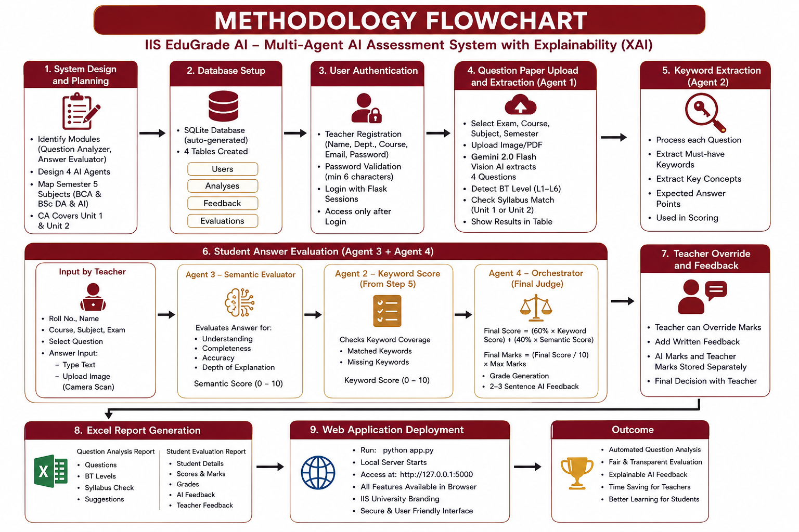

Slide 7
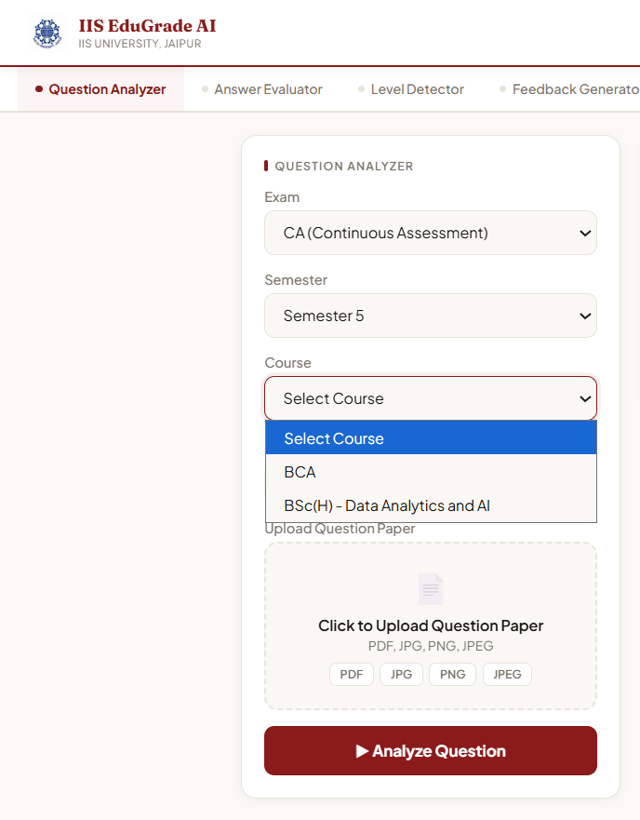
Methodology
1 Dataset and Syllabus Setup
Before building the system, all Semester 5 subjects for BCA and BSc(H) Data Analytics and AI courses were identified and mapped to their Unit 1 and Unit 2 topics as per IIS University CA exam format. This mapping was hardcoded into the backend so the system can automatically verify whether each question belongs to the correct syllabus unit when a question paper is uploaded.
Course | Subjects
BCA Sem 5 | Ethical Hacking, Web Application Development-III, Fundamentals of Testing, Mobile Application Development, Machine Learning, Cloud Computing, Presentation Skills
BSc(H) Sem 5 | Operations Research, Linear Algebra, Data Visualization, Computer Vision and IoT, Big Data and Text Mining, Presentation Skills
Figure 1 : Subject Dropdown — Course and Subject Selection

Slide 8
2. AI Agent Design
Four AI agents were designed using the Anthropic Claude API, each handling one specific task in the evaluation pipeline.
Agent 1 — Vision AI: Reads the uploaded CA question paper as image or PDF and extracts all 4 questions automatically without any manual typing.
Agent 2 — Keyword Extractor: Takes each question and identifies the must-have keywords and concepts that a correct answer should contain.
Agent 3 — Semantic Evaluator: Reads the student's answer and evaluates it for understanding, depth, and accuracy beyond just keyword matching.
Agent 4 — Orchestrator: Combines keyword score and semantic score using the formula below and produces final marks, grade, and AI feedback.
Final Score = (60% × Keyword Score) + (40% × Semantic Score)
Final Marks per Question = (Final Score / 10) × 5
Total Marks = Sum of 3 attempted questions out of 15

Slide 9
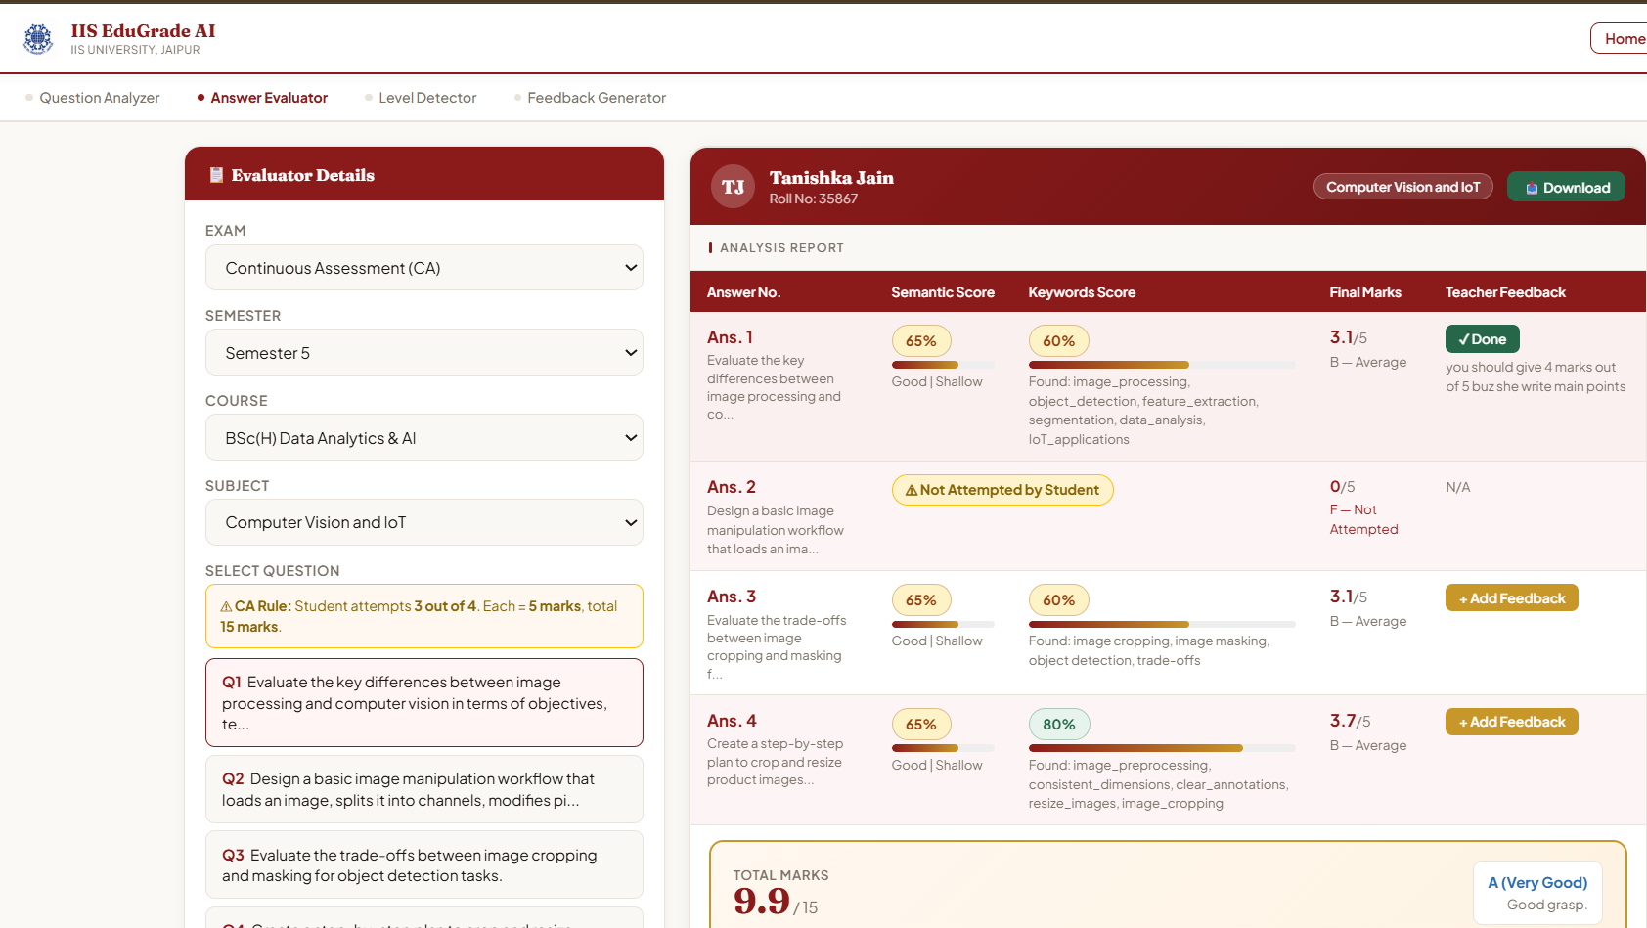
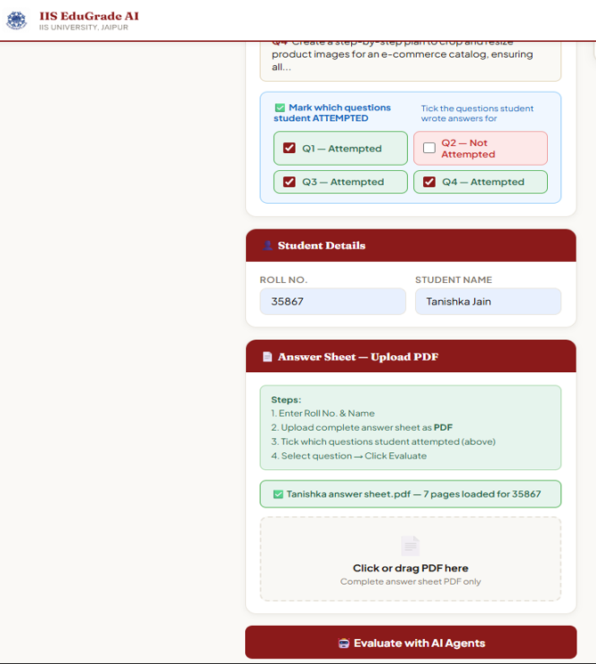
Table | What it stores
users | Name, department, course, email, password hash, role, roll number
evaluations | Student answer scores — keyword, semantic, final marks, grade, AI feedback
Figure 2 : Answer Evaluator — Analysis Report Table showing Semantic Score, Keyword Score, Final Marks

Slide 10
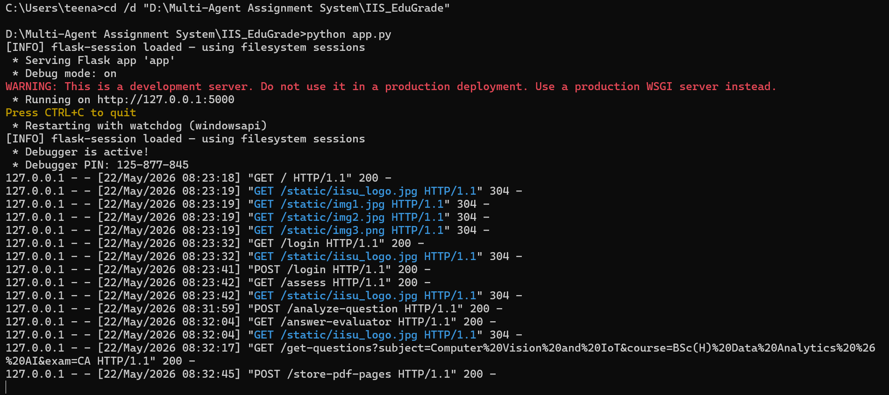
3 Backend and Database Development
The complete backend was built using Python and Flask. Flask manages all routes, user sessions, database operations, and Claude API calls. The SQLite database auto-generates on first run with the following tables:
Table | What it stores
users | Name, department, course, email, password hash, role, roll number
analyses | Question analysis results — BT level, syllabus, difficulty, quality
feedback_log | Teacher BT level and written feedback on questions
evaluations | Student answer scores — keyword, semantic, final marks, grade, AI feedback
Figure 3 : Terminal — app.py running on local server

Slide 11

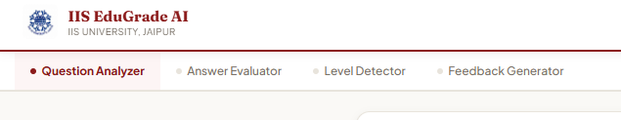
4. Frontend Development
All pages were designed using HTML, CSS, and JavaScript. The system has the following pages — Home, Login, Register, and the main Assessment page with four tabs: Question Analyzer, Answer Evaluator, Level Detector, and Feedback Generator. The complete design follows IIS University's official maroon (#8B1A1A) and gold (#C8972A) color theme using Fraunces and Plus Jakarta Sans fonts.
Figure 4: Home Page Figure 5: Assessment Page — Four Tabs

Slide 12
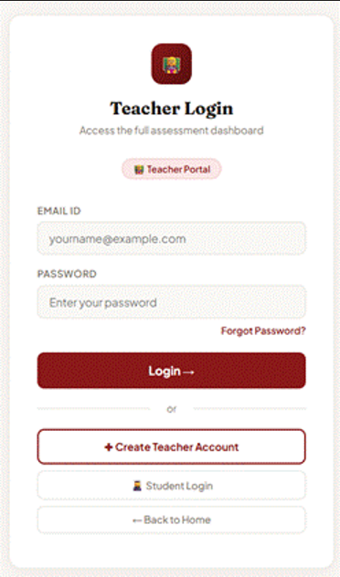
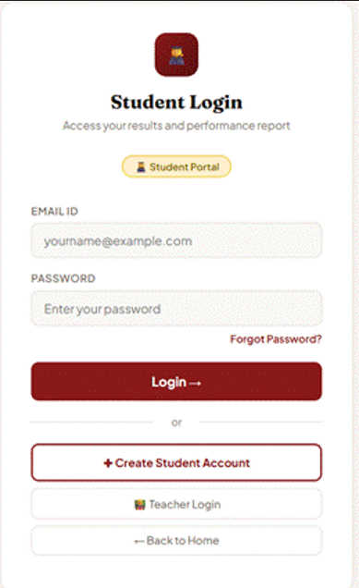
5. Role-Based Access
Separate registration and login were built for teachers and students. Teachers Create Account with name, department, course, email, and password. Students register with an additional roll number field. On login, Flask session stores the user's role. Based on role, access is restricted as follows:
Role | Access
Teacher | Question Analyzer, Answer Evaluator, Level Detector, Feedback Generator
Student | Feedback Generator only — shows only their own feedback based on roll number
Figure 6: Login Page For Teacher and Student

Slide 13
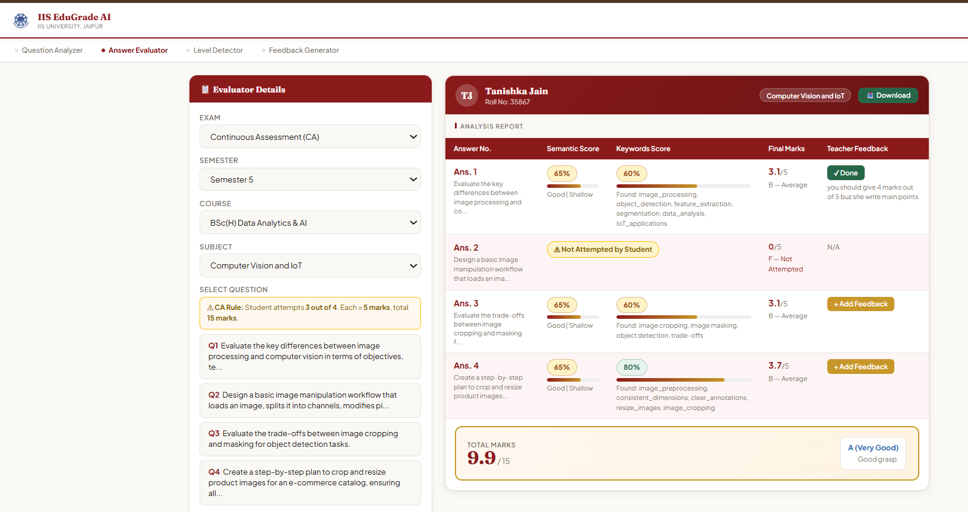
6. Answer Evaluation Pipeline
The teacher uploads the student's answer sheet as a multi-page PDF. The PDF is uploaded once and all pages are scanned together. The system reads the left side of each page to detect which answer is written where — Answer 1, Answer 2, Answer 3. As per CA rule, the paper has 4 questions but the student attempts any 3. If a question is not attempted, it shows 0 marks. Each detected answer is passed through Agents 2, 3, and 4. The result is displayed in a student card showing name, roll number, subject, answer-wise scores, and total marks out of 15 with grade.
Grade | Marks Range | Performance
O — Outstanding | 13.5 – 15 | Excellent performance
A — Good | 10.5 – 13.4 | Good understanding
B — Average | 7.5 – 10.4 | Needs improvement
C — Below Average | Below 7.5 | Requires attention
Figure 8: Answer Evaluator — Student Card with Total Marks and Grade

Slide 14
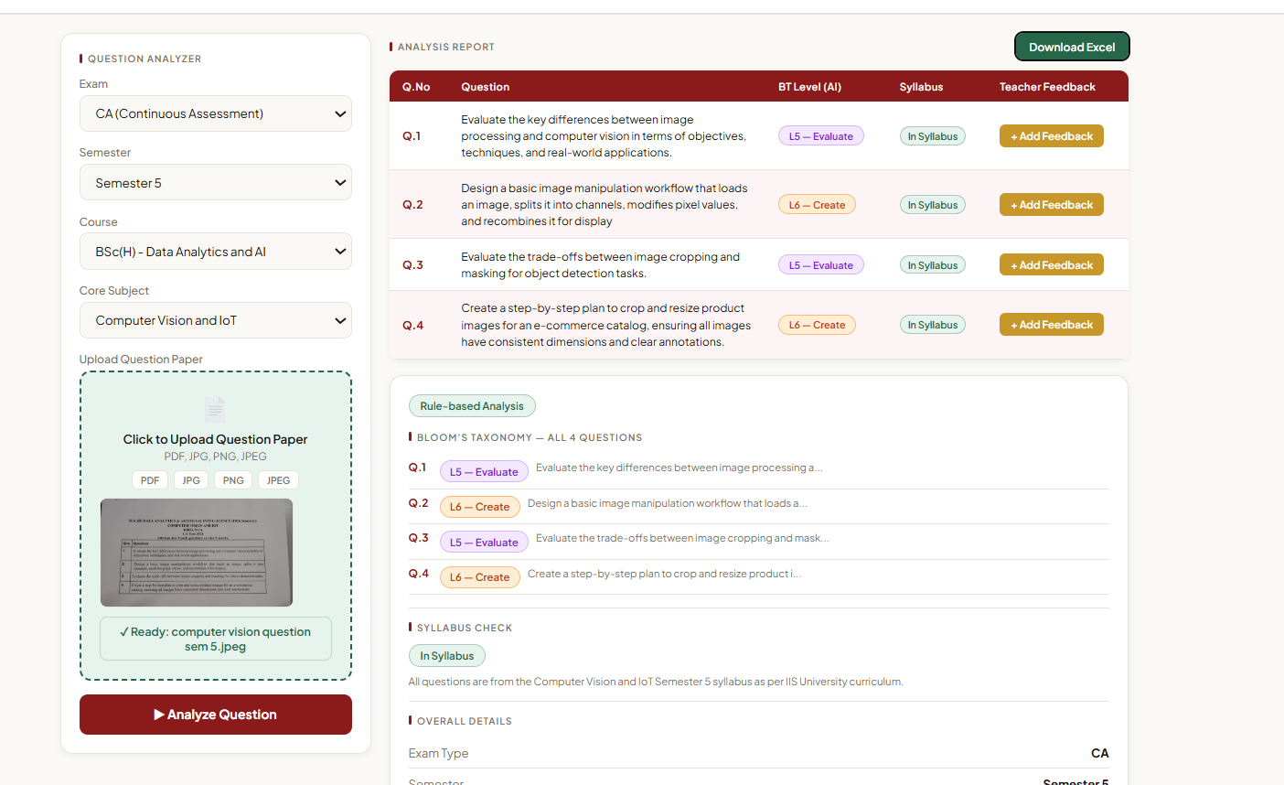
3.7 Testing and Deployment
The system was tested using real Semester 5 question papers uploaded as images and PDFs, and student answer sheets uploaded as scanned PDFs. All features including question extraction, BT level detection, syllabus check, answer evaluation, CO attainment report, student feedback, and Excel download were tested and verified. The application runs locally by executing python app.py and is accessible in the browser at http://127.0.0.1:5000.
Figure 9: Question Analyzer — BT Level Results

Slide 15
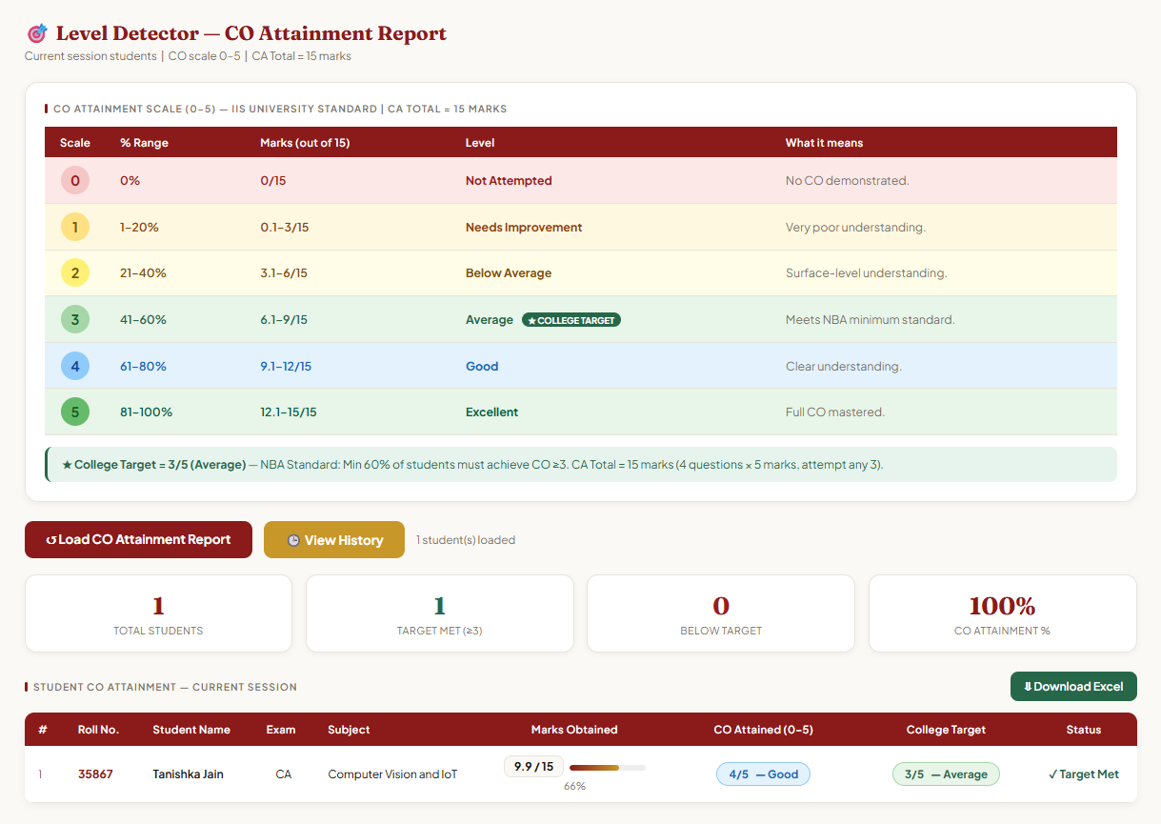
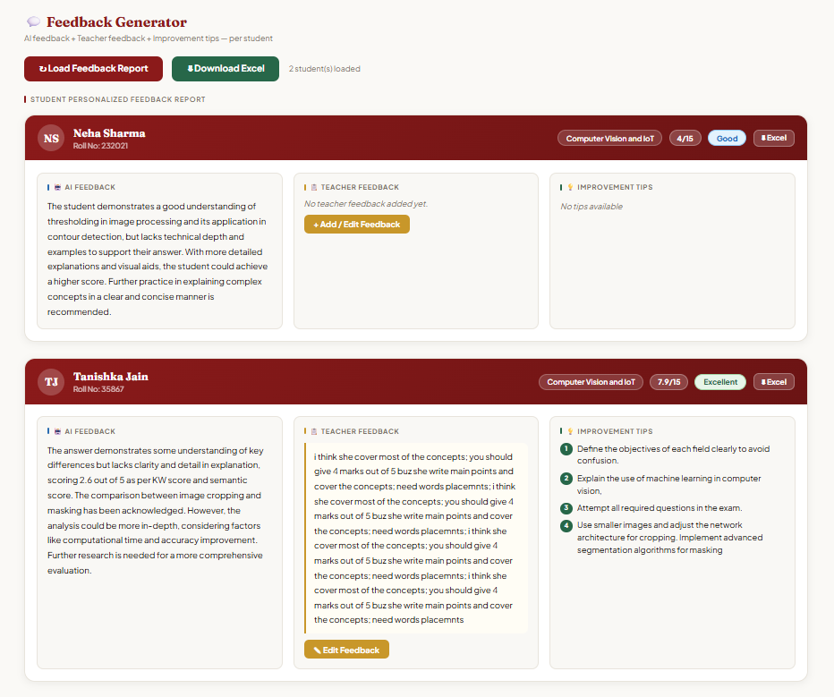
Figure 10: Level Detector — CO Attainment Report
Figure 11: Feedback Generator — Student Feedback Container

Slide 16
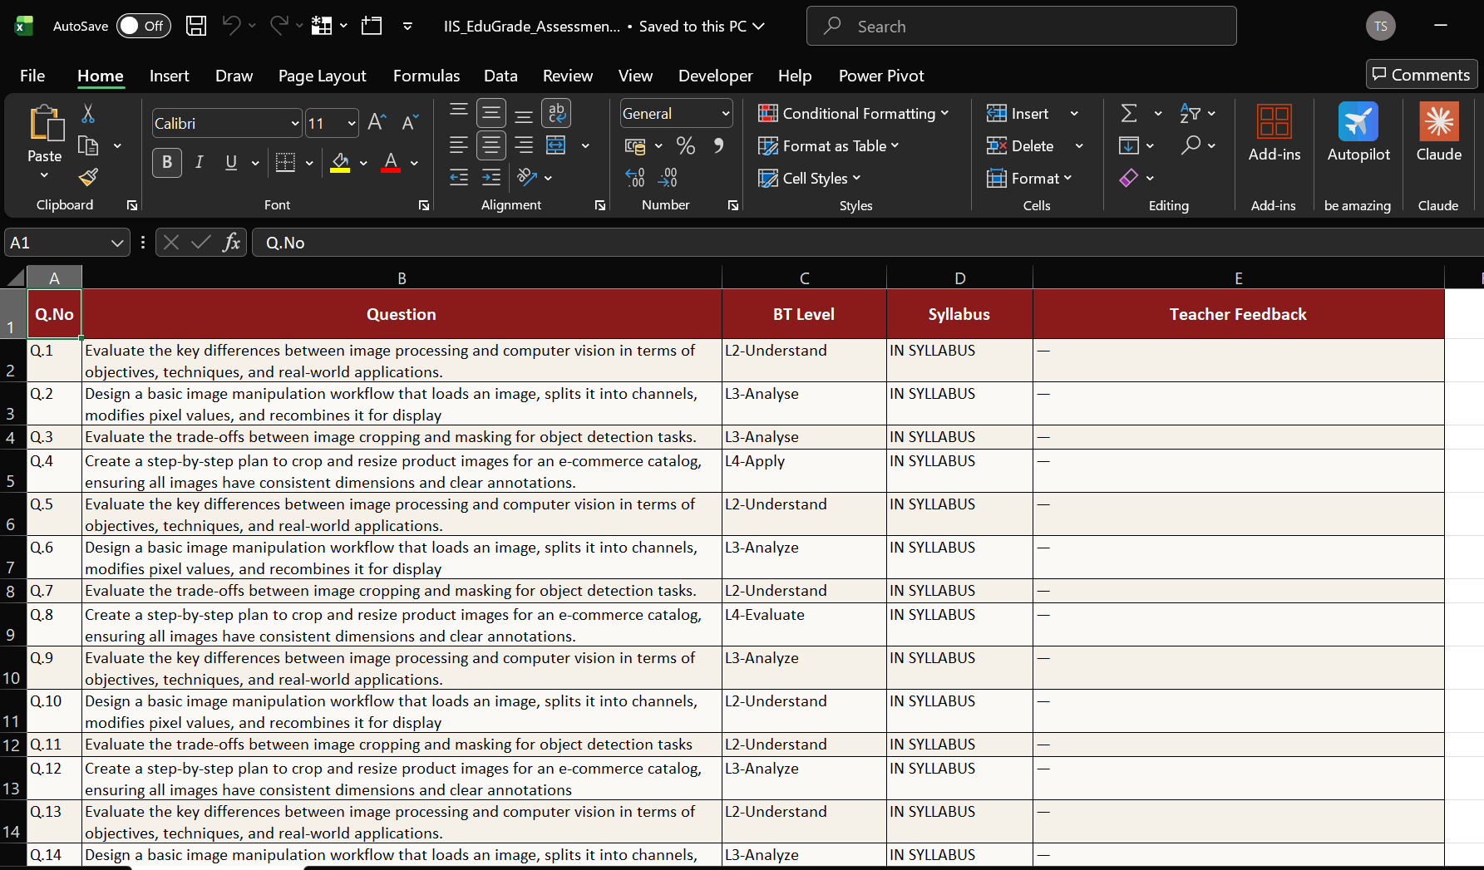
Figure 12: Downloaded Excel Report

Slide 17
FUTURE DEVELOPMENT
Expand to all semesters (1 to 6) and all exam types — Mid Term and End Term
Deploy on cloud server so teachers can access from anywhere without local setup
Add student login portal so students can view their own results and AI feedback directly
Add analytics dashboard showing class-wise performance and subject-wise weak areas
Mobile app version for easier access on phones and tablets

Slide 18
LEARNING OUTCOMES
1. Python Programming
Proficiency in Python improved significantly, especially in writing clean backend logic,
handling file uploads, processing API responses, and managing database operations.
2. Flask Framework
Gained hands-on experience in building a complete web application using Flask, including setting up routes, managing user sessions, handling GET and POST requests, and connecting frontend forms to backend logic.
3. AI and Generative AI
Learned to integrate Google Gemini 2.0 Flash API for real tasks — using Vision AI to read images, crafting effective prompts for each agent, and parsing structured AI responses.
4. Multi-Agent System Design
Understood how to break a complex task into smaller specialized agents, each with a focused role, and how to combine their outputs for a final result.
5. Explainable AI (XAI)
Learned the importance of making AI decisions transparent and how to design prompts that return not just scores but reasons, so teachers can understand and trust the system.
6. Database Management
Gained experience in designing SQLite database tables, writing queries for insert and select operations, and managing relational data across multiple tables.

Slide 19
CONCLUSION
The development of the Multi-Agent AI Assessment System represents a significant step towards automating and improving the quality of academic evaluation at IIS (Deemed to be University). By combining Vision AI, four specialized AI agents, and Explainable AI features, the system provides teachers with fast, consistent, and transparent question paper analysis and student answer evaluation. The use of Bloom's Taxonomy detection ensures that question papers maintain academic quality, while the multi-agent evaluation pipeline ensures that student answers are assessed on both keyword coverage and deeper understanding.
The human-AI collaboration feature, where teachers can override AI marks and add feedback, ensures that the final decision always remains with the teacher. This project serves as a model for how AI can be used responsibly and transparently in educational assessment.
IIS Edu Grade AI shows how AI can improve academic assessment when used thoughtfully in a university setting. By combining Vision AI, a four-agent evaluation pipeline, Bloom's Taxonomy detection, and NBA-aligned CO attainment tracking, the system provides fair and consistent results for both teachers and students. Teachers get clear insights into question quality and student performance. Students can log in independently and view their personalized feedback. This system is a practical step toward outcome-based, data-driven education at IIS University.

Slide 20
REFERENCES
1. Anderson, L. W., & Krathwohl, D. R. (2001). A Taxonomy for Learning, Teaching, and Assessing: A Revision of Bloom's Taxonomy of Educational Objectives. Longman.
2. Google Gemini API Documentation. (2024). Google AI for Developers. https://ai.google.dev/
3. Palomino, M., & Taylor, J. (2022). Automated Assessment Systems in Higher Education: A Review. Journal of Educational Technology, 18(2), 45-60.
4. Flask Documentation. (2024). Pallets Projects. https://flask.palletsprojects.com/
5. OpenPyXL Documentation. (2024). https://openpyxl.readthedocs.io/

Slide 21
Thank you

